Slide 4
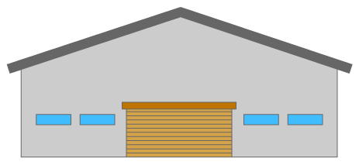

Slide 7
We need help
They need help

Slide 9
Send a number
Receive a number

Slide 12
Air on
Air off

Slide 15
C
B
A

Slide 16
C
B
A
G
D
E
F

Slide 17
C
B
A
G
D
E
F

